Slide 1
Data Literacy
What every library manager needs to know
Tiffany Rawlings
PLNZ Region 4 Representative and National Data Collection Project Lead
Library and Archive Manager, Masterton District Library

Slide 3
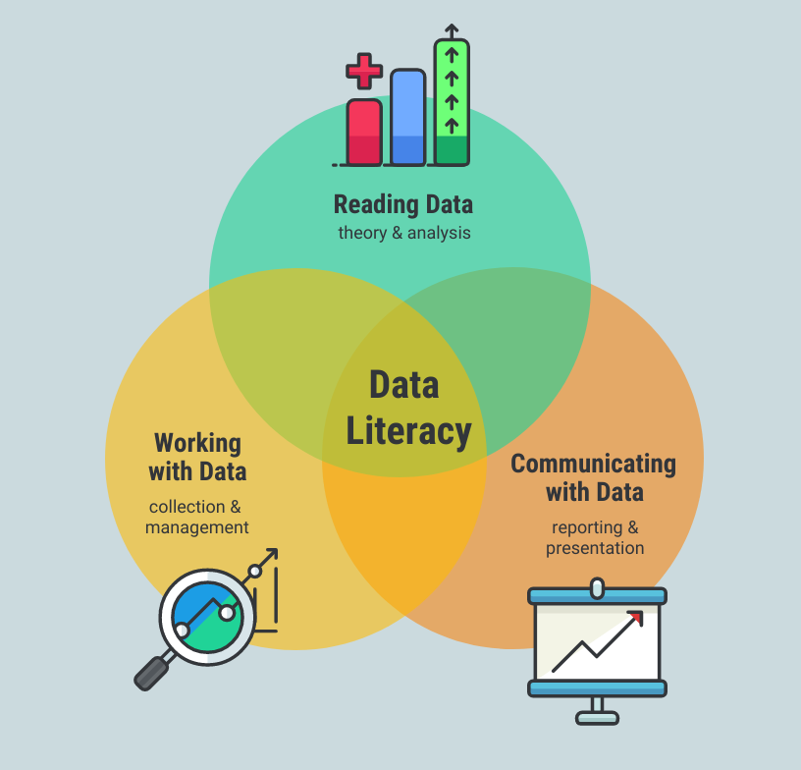
Data Literacy
Data literacy is the ability to read, understand, create and communicate data as information.

Slide 4
Why is data literacy important to librarians/managers?
Ask the right questions
Understand which data is relevant and how to test the validity of the data
Interpret the data well, so the results are useful and meaningful
Create easy-to-understand visualisations so results are conveyed accurately
Tell a story to help decision-makers see the big picture and act on the results of analysis

Slide 5
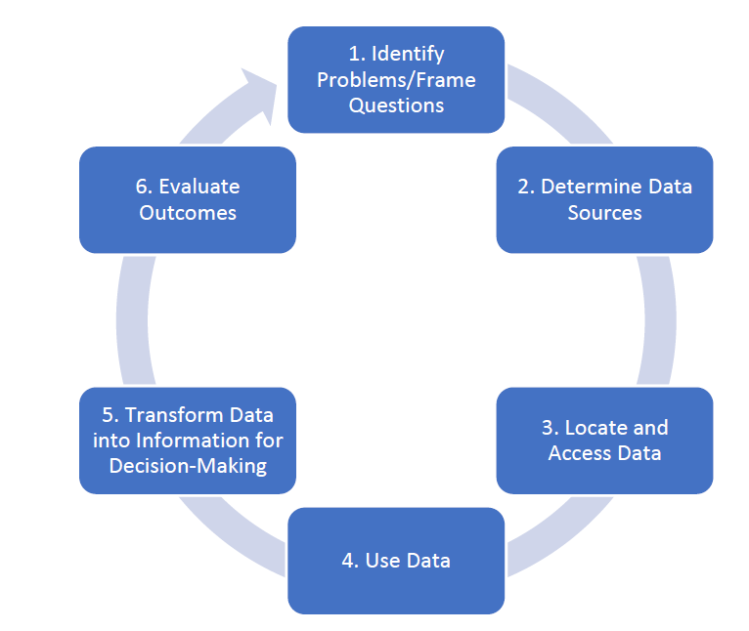
Data/Information Problem-Solving
(Adapted from Mandinach & Gummer, 2016; Eisenberg & Berkowitz, 1990)

Slide 6
Data Literacy Skills to:
Identify Problems/Frame Questions
Articulate and communicate the problem/questions
Identify the data needed to address problem/questions
Identify stakeholders
Question framing

Slide 7
Data Literacy Skills to:
Determine Data Sources
Identify possible sources of data
Understand data properties
Understand data quality

Slide 8
Data Literacy Skills to:
Locate and Access Data
Data Location
Understand how to access data

Slide 9
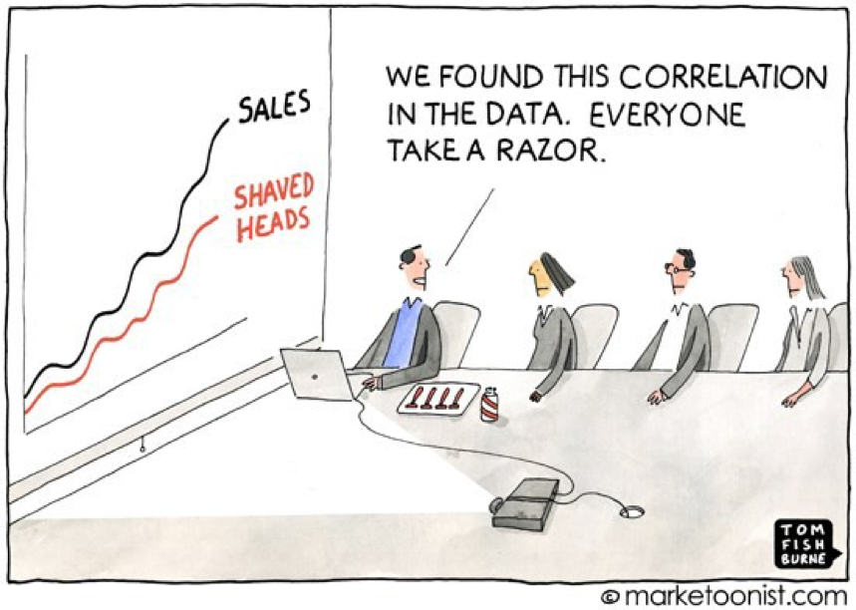
Data Literacy Skills to:
Use Data
Understand data preparation for analysis
Understand data visualisation strategies
Recognise the difference between correlation and causation

Slide 10
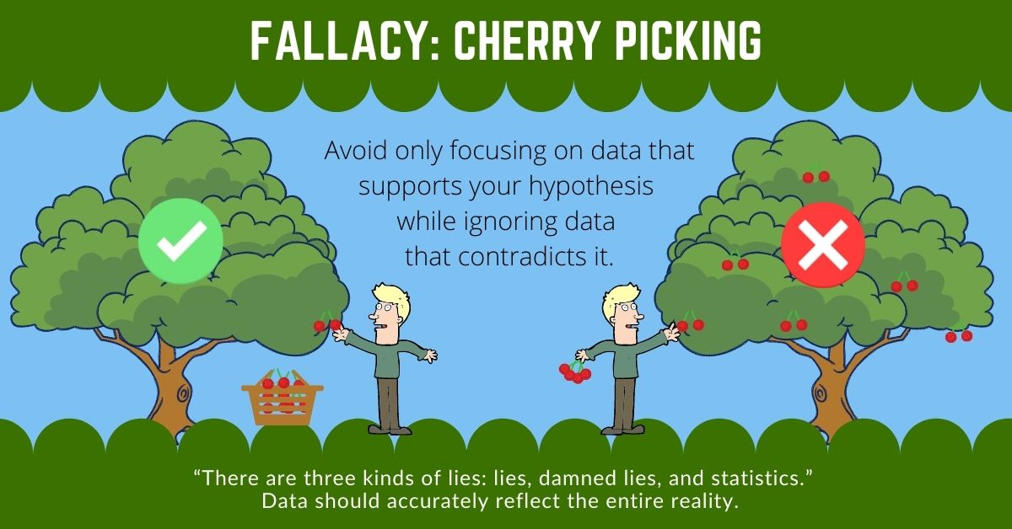
Data Literacy Skills to:
Use Data
Understands/avoids/recognise logical fallacies
Use data technologies to support data use
Data Comprehension

Slide 11
Data Literacy Skills to:
Transform Data into Information Decision Making
Understand how to interpret data
Test assumptions
Generate hypotheses
Consider impact and consequences
Understand context for the decision
Determine next steps

Slide 12
Data Literacy Skills to:
Evaluate Outcomes
Re-examine problem/question
Monitor changes
Debrief

Slide 13
17 Key Traits of DATA LITERACY
Developed by Ben Jones founder of Data Literacy, LLC.
Data Literacy Webinar 001 - 17 Key Traits of Data Literacy - YouTube
Has KNOWLEDGE of:
1. Basic Elements of Data
2. Data Storage Methods
3. Data Analysis Principles
4. Data Visualization Rule of Thumb
Puts to use the following SKILLS:
5. Reads Visual Displays of Data
6. Prepares Data for Analysis
7. Explores Data
8. Creates Clear Visuals
9. Communicates Data Effectively
Embodies these ATTITUDES:
10. Inclusive
11. Confident
12. Alert
13. Ethical
Practices these BEHAVIOURS:
14. Resourcefully Utilizes Data
15. Continuously Improves Data
16. Effectively Advocates for Data
17. Enthusiastically Spreads Data Literacy

